Slide 1
Object Oriented Programming with Java
Chapter 8
Arrays

Slide 2
Declaring Arrays
Array
A named list of data items
All data items have the same data type
Declare an array variable
The same way as declaring any simple variable
Insert a pair of square brackets after the type
double[] salesFigure;
int[] idNums;
Arrays are often named using a plural noun such as: salesFigures.
Arrays are often named by adding a final word that implies a group, such as salesList, salesTable, or salesArray.

Slide 3
Declaring Arrays
Still need to reserve memory space:
salesFigures = new double[20];
double[] salesFigures = new double[20]; (Alternative ways to declare and create an array reserving 20 memory locations for 20 double values.)
Subscript
An integer contained within square brackets
Indicates one of the array’s variables or elements
A subscript that is too small or too large for an array is out of bounds
An error message is generated

Slide 4
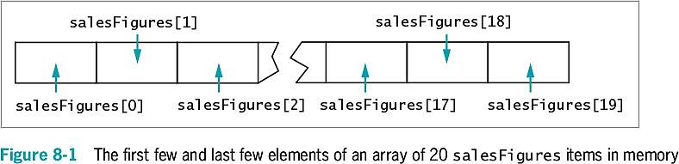
Declaring Arrays
An array’s elements are numbered beginning with 0
You can legally use any subscript from 0 through 19 when working with an array that has 20 elements
When working with any individual array element, treat it no differently than a single variable of the same type
Example: sale[0] = 2100.00;

Slide 5
Initializing an Array
A variable with a reference type, such as an array, holds a memory address where a value is stored
Array names:
Represent computer memory addresses
Contain references
When you declare an array name:
No computer memory address is assigned
The array has the special value null
Unicode value ‘\u0000’

Slide 6
Initializing an Array
Use the keyword new to define an array
The array name acquires the actual memory address value
int[] someNums = new int[10];
Each element of someNums has a value of 0
char array elements
Assigned ‘\u0000’
boolean array elements
Automatically assigned the value false
Strings and arrays of objects
Assigned null by default

Slide 7
Initializing an Array
Assign nondefault values to array elements upon creation
int[] tenMult = {10, 20, 30, 40, 50, 60};
An initialization list initializes an array
Values are separated by commas and enclosed within curly braces
Populating an array
Providing values for all the elements in an array

Slide 8
Using Variable Subscripts with an Array
Scalar
A primitive variable
Power of arrays
Use subscripts that are variables rather than constant subscripts
Use a loop to perform array operations
for (sub = 0; sub < 5; ++sub)
scoreArray[sub] += 3;

Slide 9
Using Variable Subscripts with an Array
When an application contains an array:
Use every element of the array in some task
Perform loops that vary the loop control variable
Start at 0
End at one less than the size of the array
length field: number of elements in the array
for(sub = 0; sub < scoreArray.length; ++sub)
scoreArray[sub] += 3;
length is a property of the object
Is a field
Cannot be used as an array method
Automatically assigned a value for every array created

Slide 10
Using Variable Subscripts with an Array
Enhanced for loop
Allows you to cycle through an array without specifying starting and ending points for the loop control variable
for(int val : scoreArray)
System.out.println(val);

Slide 11
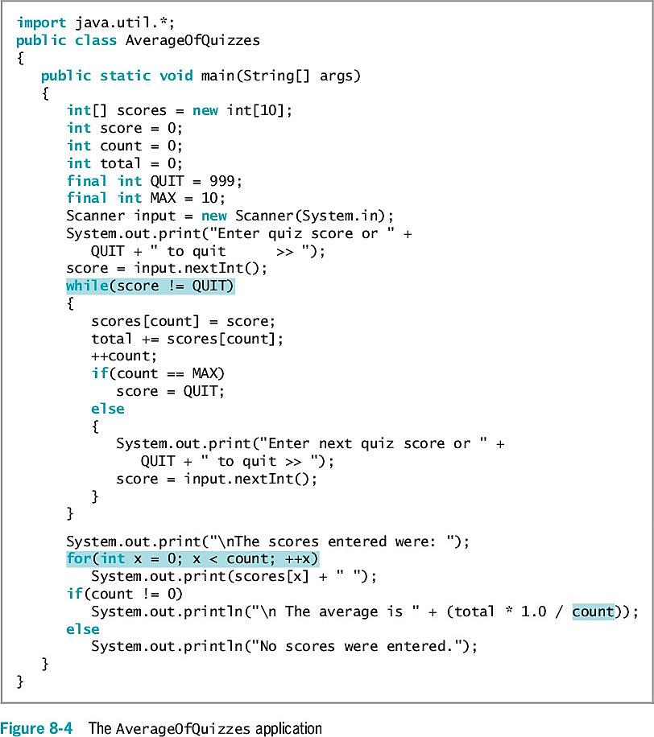
Using Part of an Array
How many scores will this program print out?

Slide 12
Declaring and Using Arrays of Objects
Create an array of Employee objects
Employee[] emp = new Employee[7];
Must call seven individual constructors
final double PAYRATE = 6.35;
for(int x = 0; x < NUM_EMPLOYEES; ++x)
emp[x] = new Employee(101 + x, PAYRATE);

Slide 13
Using the Enhanced for Loop with Objects
Use the enhanced for loop to cycle through an array of objects
Eliminates the need to use a limiting value
Eliminates the need for a subscript following each element
for(Employee worker : emp)
System.out.println(worker.getEmpNum() + " " + worker.getSalary();

Slide 14
Manipulating Arrays of Strings
Create an array of Strings
String[] deptNames = {"Accounting", "Human Resources", "Sales"};
for(int a = 0; a < deptNames.length; ++a)
System.out.println(deptNames[a]);

Slide 15
Searching an Array and Using Parallel Arrays
To determine whether a variable holds one of many valid values:
Use a series of if statements
Compare the variable to a series of valid values
Searching an array
Compare the variable to a list of values in an array
for(int x = 0; x < validValues.length; ++x)
{
if(itemOrdered == validValues[x])
validItem = true;
}

Slide 16
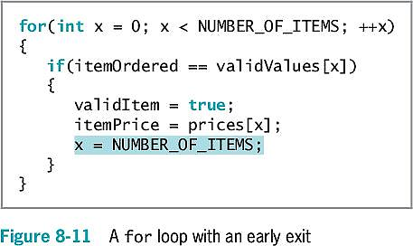
Using Parallel Arrays
Parallel array
One with the same number of elements as another
The values in corresponding elements are related
An alternative for searching
Use the while loop

Slide 17
Passing Arrays to and Returning Arrays from Methods
Pass a single array element to a method
Same as passing a variable
Passed by value
A copy of the value is made and used in the receiving method
All primitive types are passed this way
Reference types
The object holds a memory address where the values are stored
The receiving method gets a copy of the array’s actual memory address
The receiving method has the ability to alter the original values in the array elements

Slide 18
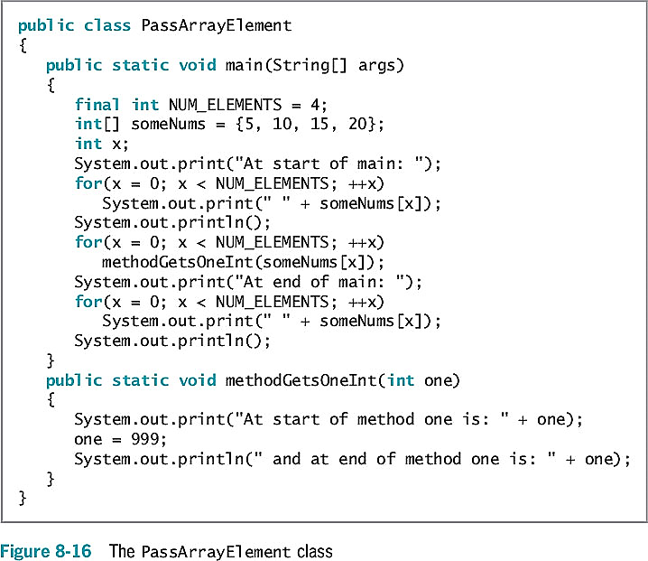
Passing Arrays to and Returning Arrays from Methods
What will the first for loop print out?
What will the second for loop print out?
What will the third for loop print out?

Slide 19
Returning an Array from a Method
A method can return an array reference
Include square brackets with the return type in the method header

Slide 20
Chapter 9
Advanced Array Concepts

Slide 21
Sorting Array Elements Using the Bubble Sort Algorithm
Sorting
The process of arranging a series of objects in some logical order
Ascending order
Begin with the object that has the lowest value
Descending order
Begin with the object that has the largest value
Simplest possible sort
Involves two values that are out of order
Swap two values (valA = 16, valB = 2)
temp = valA; // 16 goes to temp
valA = valB; // 2 goes to valA
valB = temp; // 16 goes to valB

Slide 22
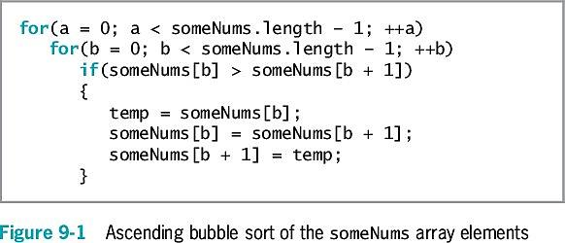
Using the Bubble Sort Algorithm
Bubble sort
You continue to compare pairs of items, swapping them if they are out of order
The smallest items “bubble” to the top of the list, eventually creating a sorted list

Slide 23
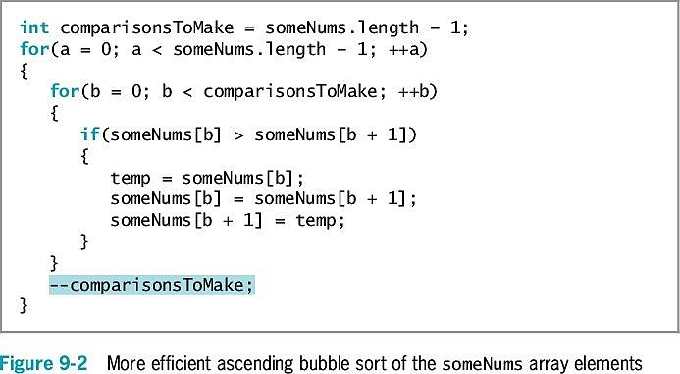
Using the Bubble Sort Algorithm

Slide 24
Sorting Arrays of Objects
You can sort arrays of objects in much the same way that you sort arrays of primitive types
Major difference
Make the comparison that determines whether to swap two array elements
Sort based on a particular object field

Slide 25
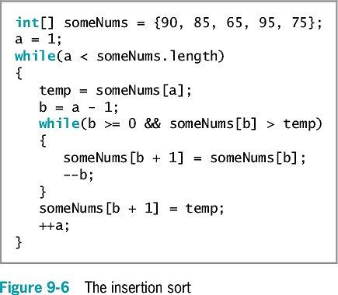
Sorting Array Elements Using the Insertion Sort Algorithm
Insertion sort
A sorting algorithm that enables you to look at each list element one at a time
Move items down if the tested element should be inserted prior to other elements
Similar to the technique that sorts a group of objects manually

Slide 26
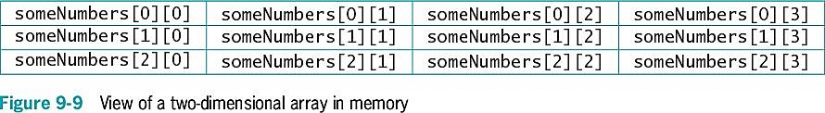
Using Two-Dimensional and Other Multidimensional Arrays
One-dimensional or single-dimensional array
An array that you can picture as a column of values
Elements are accessed using a single subscript
Two-dimensional arrays
Have two or more columns of values
Have rows and columns
Use two subscripts
Are often called a matrix or table
int[][] someNumbers = new int[3][4];

Slide 27
Using Two-Dimensional and Other Multidimensional Arrays
int[][] rents = { {400, 450, 510},
{500, 560, 630},
{625, 676, 740},
{1000, 1250, 1600} };
What is the value of rents[2][0]?

Slide 28
Passing a Two-Dimensional Array to a Method
Pass the array name just as you do with a one-dimensional array
public static void displayScores(int[][]scoresArray)

Slide 29
Using the length Field with a Two-Dimensional Array
The length field holds the number of rows in the array
rents.length
Each row has a length field that holds the number of columns in the row
rents[1].length

Slide 30
Understanding Ragged Arrays
Ragged array
A two-dimensional array with rows of different lengths
To create a ragged array:
Define the number of rows for a two-dimensional array
Do not define the number of columns in the rows
Then declare the individual rows

Slide 31
Using Other Multidimensional Arrays
Multidimensional arrays
Arrays with more than one dimension
Create arrays of any size
Keep track of the order of variables needed as subscripts
Do not exhaust your computer’s memory

Slide 32
Using the Arrays Class
Arrays class
Must be imported from the java.util library
Contains many useful methods for manipulating arrays
static methods
Use them with the class name without instantiating an Arrays object
binarySearch() method
A convenient way to search through sorted lists of values of various data types
The list must be in order

Slide 33
Using the Arrays Class

Slide 34
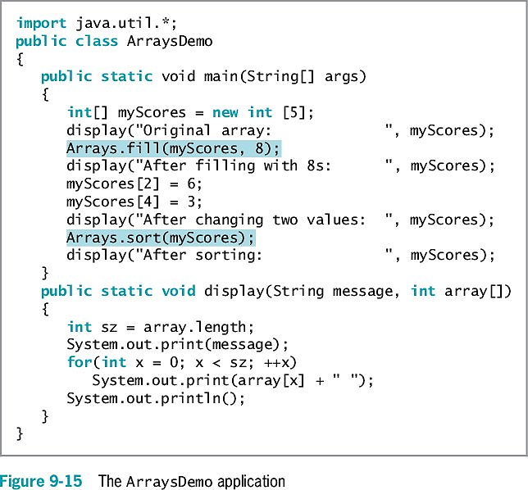
Using the Arrays Class
What will the third (last) call to the display() method print out?

Slide 35
Using the ArrayList Class
The ArrayList class provides some advantages over the Arrays class
Dynamically resizable
Can add an item at any point in an ArrayList container
Can remove an item at any point in an ArrayList container
Capacity
The number of items an ArrayList can hold without having to increase its size

Slide 36
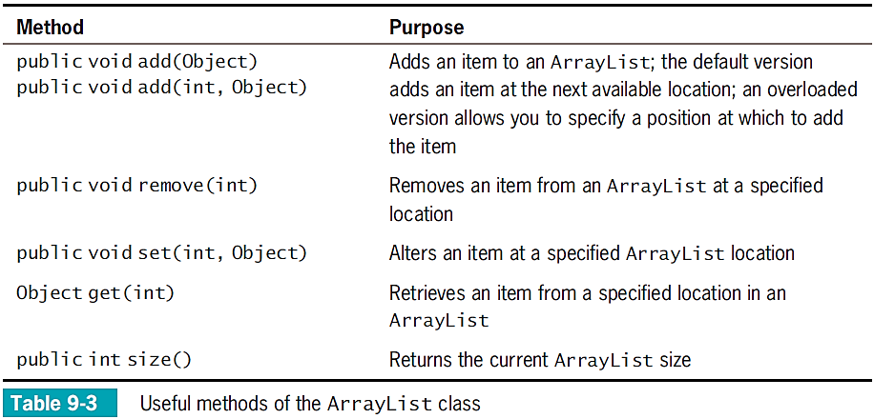
Using the ArrayList Class

Slide 37
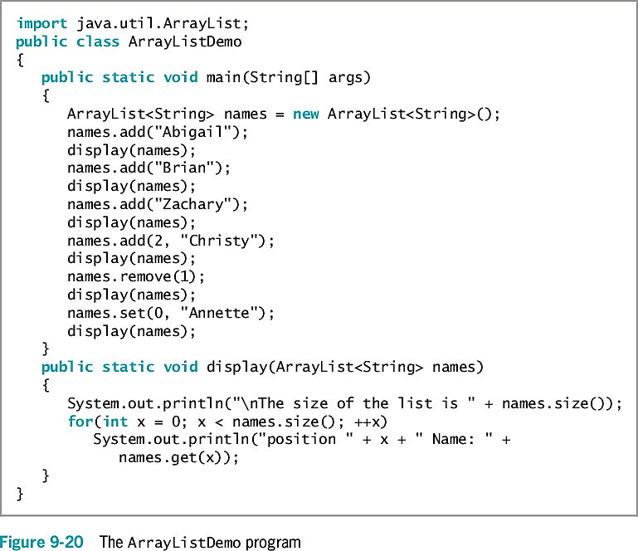
Using the ArrayList Class
What will each call to the display() method print out?
Implement and run this program to confirm your answer.
Notes:
Brainstorm the class and write the expected output on the board.
If the answer is not 100% correct, let the students implement and run the program. Then discuss the mistake made during the brainstorming.

Slide 38
Creating Enumerations
Enumerated data type
A programmer-created data type with a fixed set of values
To create an enumerated data type, use:
The keyword enum
An identifier for the type
A pair of curly braces that contain a list of the enum constants
enum Month {JAN, FEB, MAR, APR, MAY, JUN,
JUL, AUG, SEP, OCT, NOV, DEC};

Slide 39
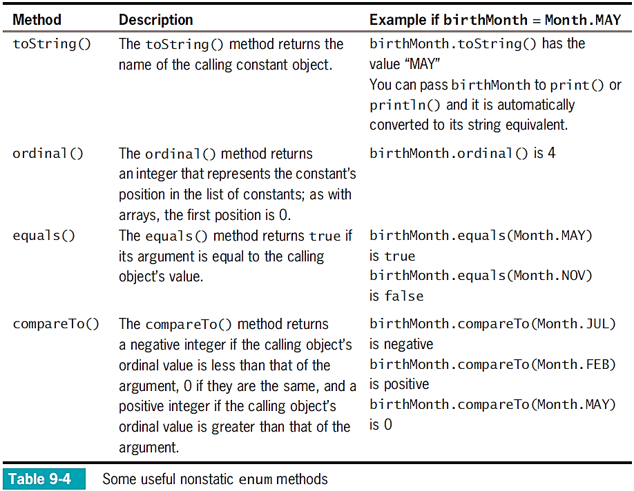

Slide 40
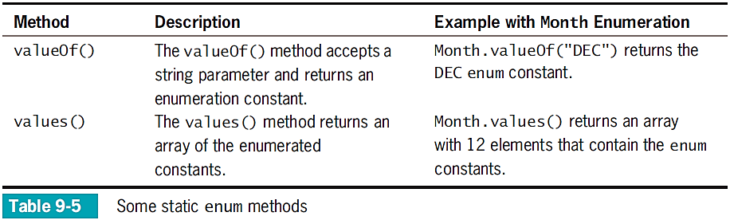
Creating Enumerations

Slide 41
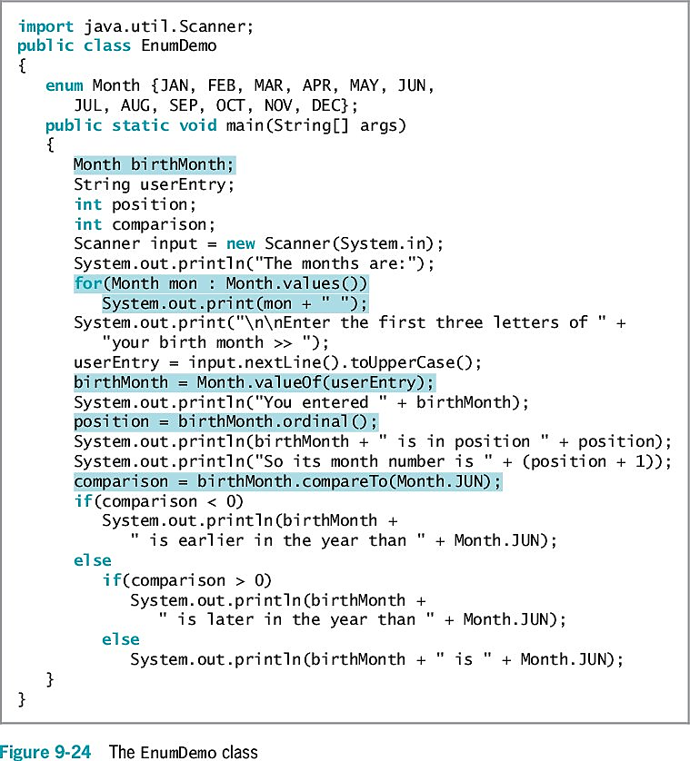
Creating Enumerations
What will this program display if the user enters “Oct”?

Slide 42
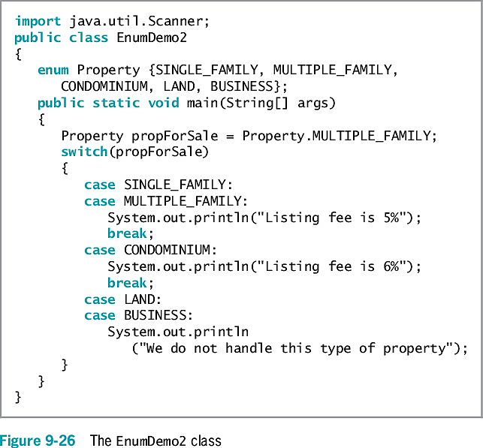
Creating Enumerations
You can declare an enumerated type in its own file
Filename matches the type name and has a .java extension
Starting with Java 7, you can use comparison operators with enumeration constants
You can use enumerations to control a switch structure

Slide 43
Creating Enumerations
Advantages of creating an enumeration type:
Only allowed values can be assigned
Using enums makes the values type-safe
Provides a form of self-documentation
You can also add methods and other fields to an enum type
Type-safe
Describes a data type for which only appropriate behaviors are allowed

Slide 44
Don’t Do It
Don’t forget that the lowest array subscript is 0
Don’t forget that the highest array subscript is one less than the length
Don’t forget that length is an array property and not a method
Don’t assume that an array of characters is a string
Don’t forget that array names are references
Don’t use brackets with an array name when you pass it to a method
Don’t forget that the first subscript used with a two-dimensional array represents the row, and that the second subscript represents the column
Don’t try to store primitive data types in an ArrayList structure
Don’t think enum constants are strings; they are not enclosed in quotes

Slide 45
Summary
Array
A named list of data items
All have the same type
Array names
Represent computer memory addresses
Shorten many array-based tasks
Use a variable as a subscript
length field
Contains the number of elements in an array
You can declare arrays that hold elements of any type, including Strings and other objects
Search an array to find a match to a value
Perform a range match
Pass a single array element to a method

Slide 46
Summary
Sorting
The process of arranging a series of objects in some logical order
Two-dimensional arrays
Both rows and columns
Arrays class
ArrayList class
A programmer-created data type with a fixed set of values is an enumerated data type

